Slide 1
VOICE ASSISTANTS
Mugash priyan U [RA2212704010028]
JAGADISH V [RA2212704010025]

Slide 2
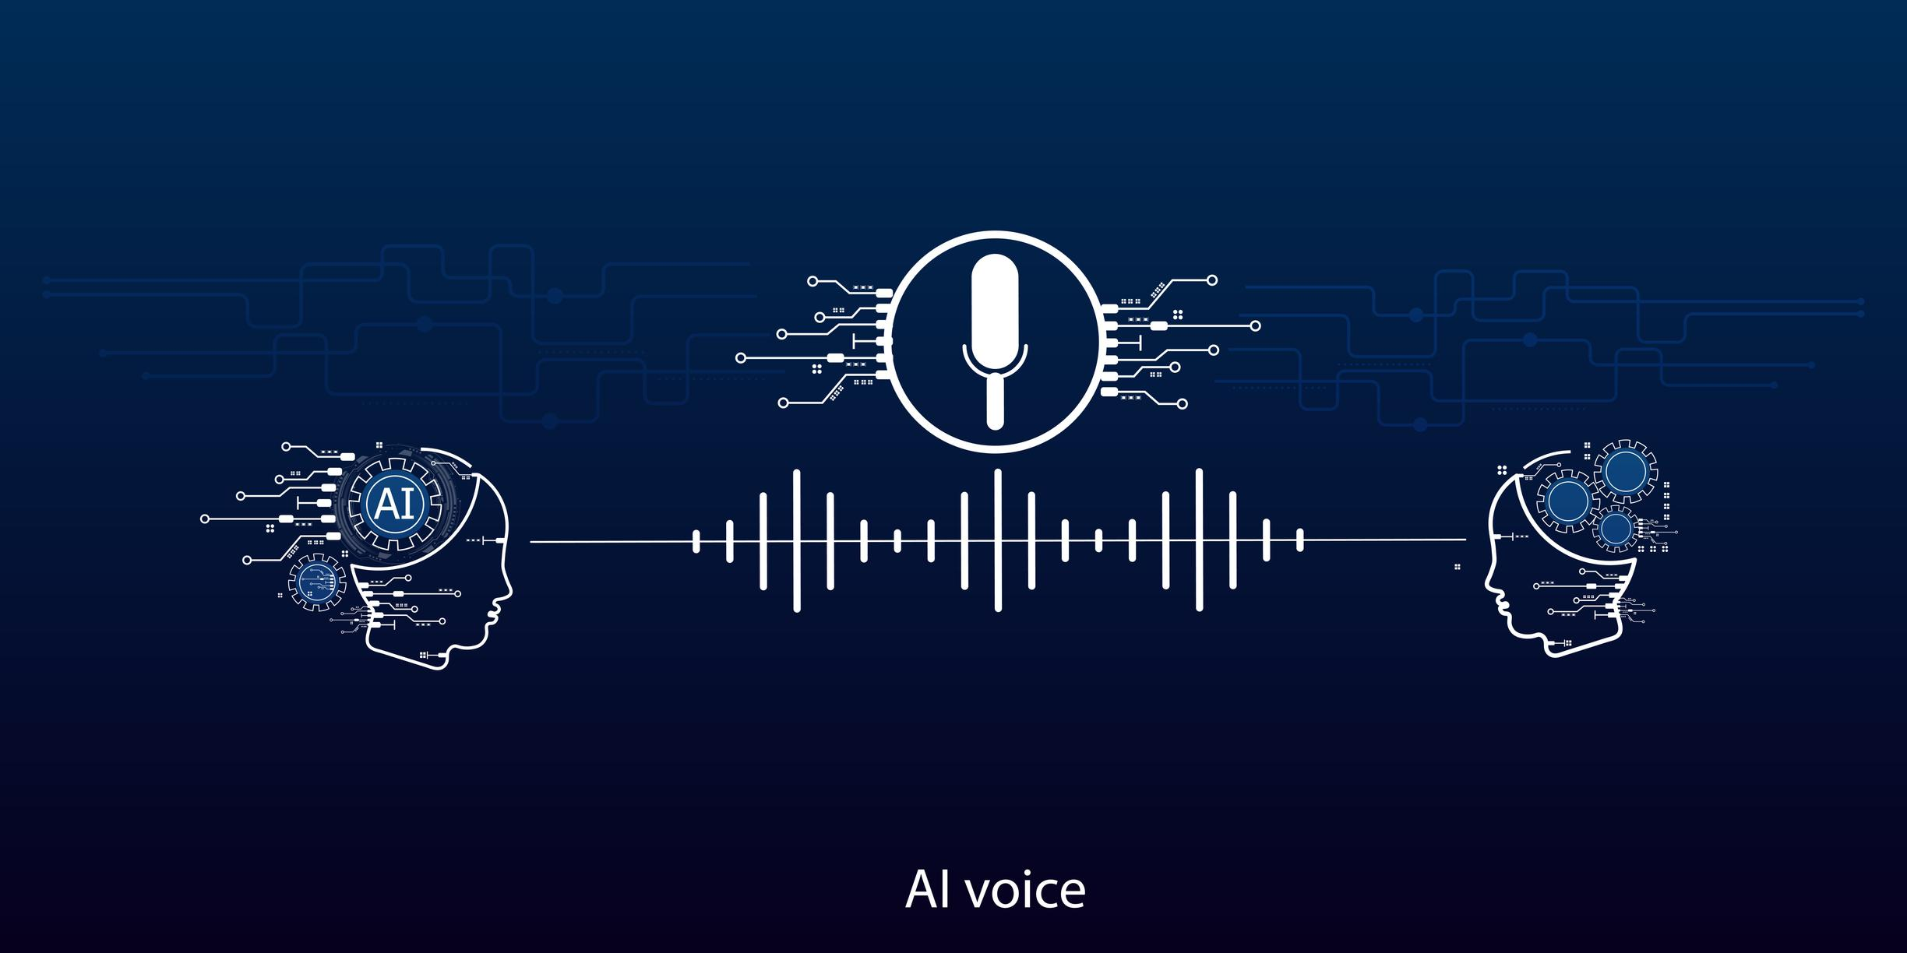
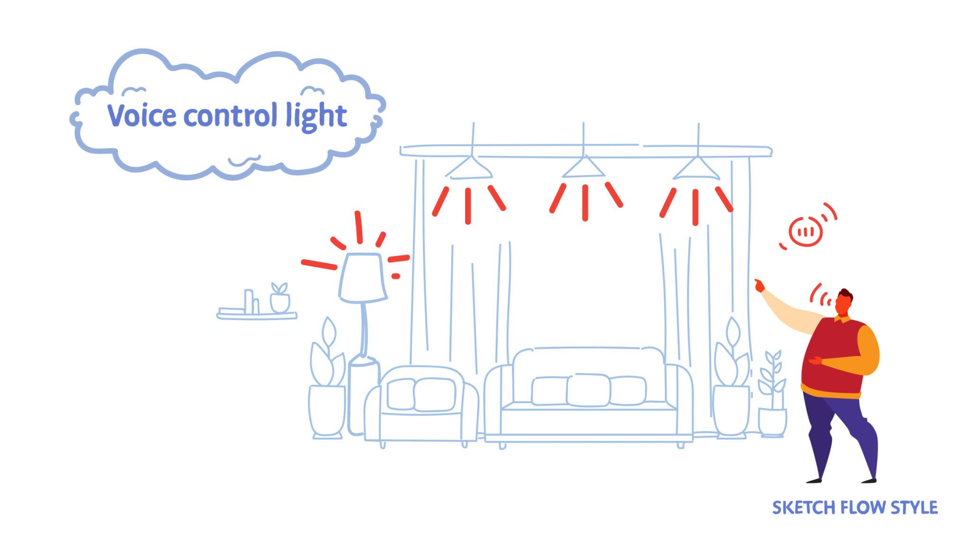
What is a Voice Assistant?
Voice assistants are AI systems that understand speech and respond using voice.
Examples:
Mobile assistants
Smart speakers
Car voice systems

Slide 3
Technologies Used in Voice Assistants
Automatic Speech Recognition (ASR) → Speech to Text
Natural Language Understanding (NLU) → Understand Meaning
Dialogue Management → Decide Response
Text To Speech (TTS) → Convert Text to Voice

Slide 4
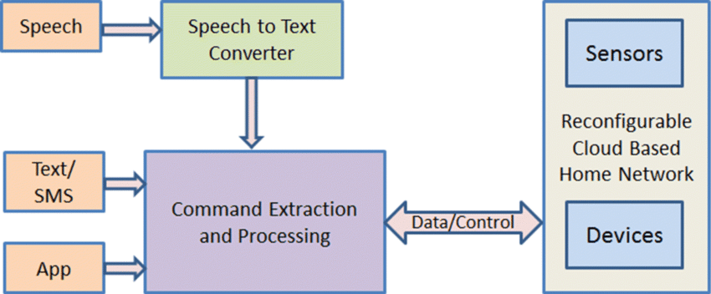
How Voice Assistants Work (Architecture)

Slide 5
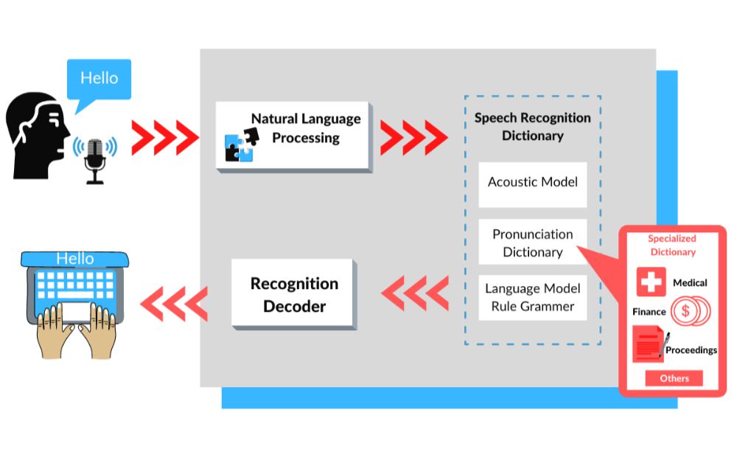

Slide 6
NLP Role in Voice Assistants
Intent Detection
Entity Recognition
Context Understanding
Language Translation
Sentiment Detection

Slide 7
Applications of Voice Assistants
Smart Homes
Customer Support
Healthcare
Education
Banking

Slide 8
Advantages of NLP in Voice Assistant
1. Improves Accessibility
2. Saves Time
3. Hands-Free Technology
4. Business Automation
5. Supports Smart Living

Slide 9
Challenges / Limitations
1. Accent recognition issues
2. Privacy concerns
3. Internet dependency
4. Background noise problems
5. Data security risks

Slide 10

Future of Voice Assistants
Better multilingual support
Emotion detection
Offline voice assistants
Integration with AR/VR
More personalized assistants

Slide 11

QUESTIONNAIRE
Q1. What is the primary function of Automatic Speech Recognition (ASR)?
A) Convert text into audio B) Identify emotional tone C) Convert speech into text D) Generate chatbot responses
Answer: C) Convert speech into text

Slide 12
QUESTIONNAIRE
Q2) Which of the following best describes personalization in voice assistants?
A) Using fixed responses for all users B) Learning user behavior and preferences C) Increasing hardware performance D) Reducing cloud storage
Answer: B) Learning user behavior and preferences

Slide 13
QUESTIONNAIRE
Q2) Which of the following best describes personalization in voice assistants?
A) Using fixed responses for all users B) Learning user behavior and preferences C) Increasing hardware performance D) Reducing cloud storage
Answer: B) Learning user behavior and preferences

